Slide 1
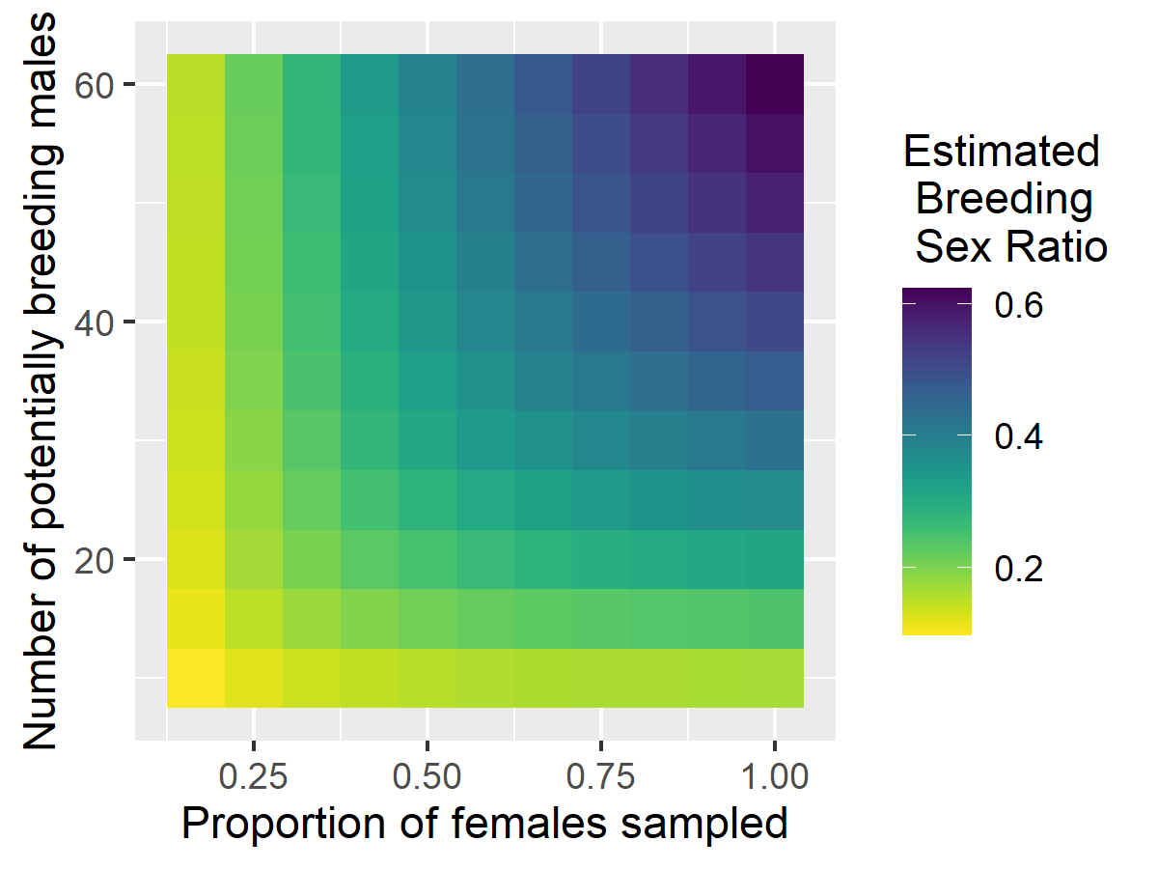
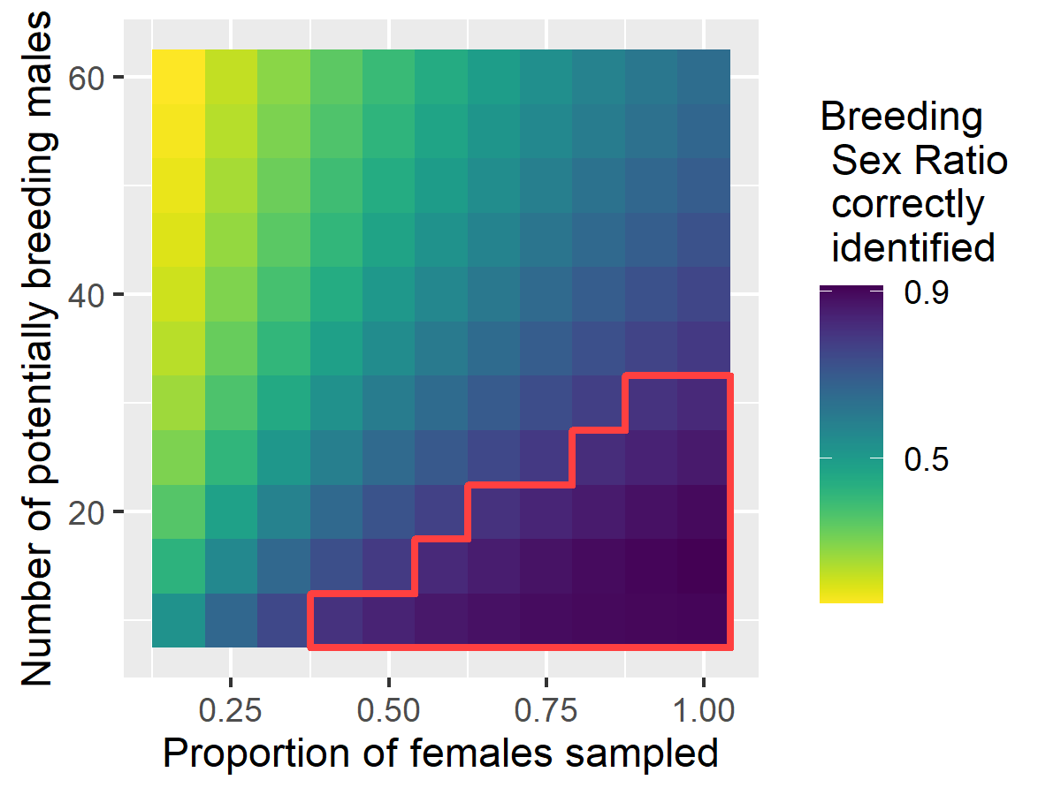

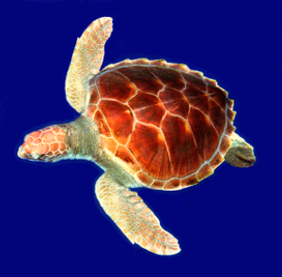
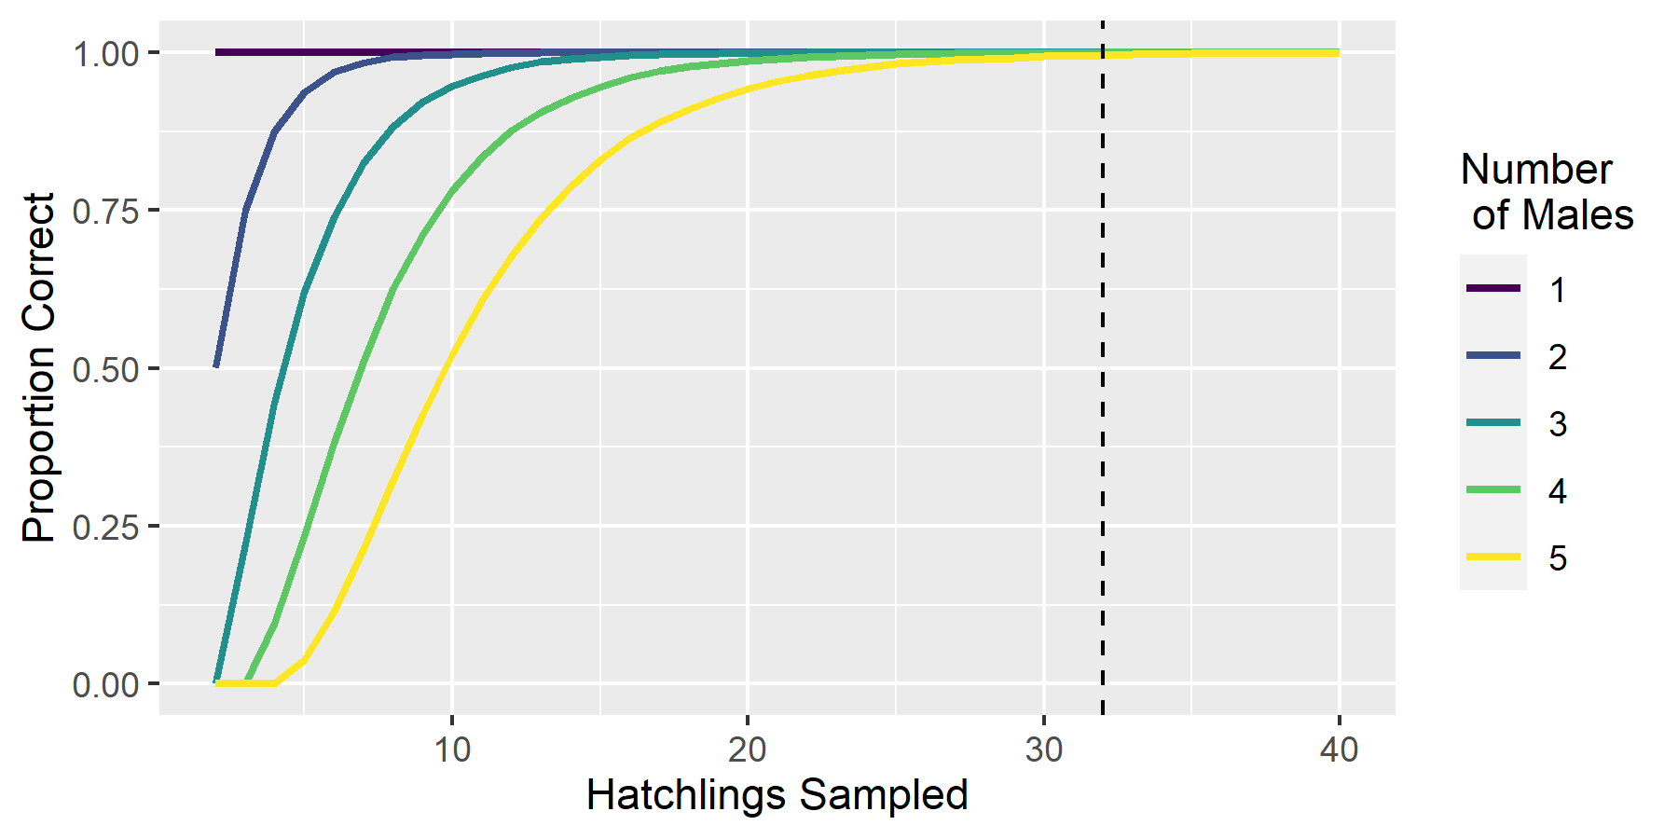





Quantitative modeling to understand how sea turtle populations will respond to climate warming
Figure 2: How many females should we sample to robustly estimate the number of breeding males?
V. Quennessen¹*, M. Fuentes², L. Komoroske³, and J. W. White¹
¹ Oregon State University, ² Florida State University, ³ UMass Amherst
victoria.quennessen@oregonstate.edu @frenchita_
Problem
Sea turtles have temperature-dependent sex determination: hatchling sex is determined by incubation temperature.
Global climate change -> warmer nests -> heavier female hatchling bias
Methods
Study population: green turtles in Fernando de Noronha, Brazil
Use parentage analysis of hatchlings to estimate breeding sex ratio
Simulations to estimate how many hatchlings / nests are needed for a robust estimate
Probability > 0.8
a
b
Figure 1. How many hatchlings from a nest should we sample to robustly estimate the true number of males that contributed to fertilizing it?
100,000 simulations run for each number of males and sample size
Assumptions
Same as those from Figure 1
Multiple nests are sampled for each female to identify all the contributing males
Males can mate with up to 10 females
Females can mate with up to 5 males
Simulations for Figure 2
1. Simulate breeding
1. Simulate mating
3. Calculate values
2. Simulate sampling
Collaborators sample 32 eggs from each nest
Females:
. . .
Females sampled
Males they mated with
a. Estimate breeding sex ratio
1
2
60
Males detected 15
BSR = -------------------- = ----- = 0.25
Total females 60
Pool of males:
n = total
potential breeding males
1
1
1
1
1
1
1
1
1
1
1
1
n
2
3
2
2
2
2
2
2
2
2
2
2
56
4
55
25
2
20
b. Calculate probability of correctly estimating BSR
3
3
3
3
3
3
3
3
3
3
17
34
19
. . .
8
10
59
1
Number of simulations correct Prob = ----------------------------------------
Total simulations = 100,000
100,000 simulations run for each number of males and sample size
Assumptions
Mating is random
All males contribute to egg fertilization equally
Equal probabilities of females mating with 1 – 5 males
n
n
n
n
n
n
n
n
n
n
23
12
43
2
43
37
Future work
Develop a size- and sex-structured population model informed by field data
Explore the probability of population survival under different scenarios:
Behavioral adaptations
Genetic adaptations
Importance
Inform conservation efforts for green turtle populations worldwide

